Slide 1

Wisconsin Remuneration Description Enhancement
Tad Cleveland, Joseph Moreth, Matthew Logan
Notes:
Layout tips
To adjust image after it is placed without manipulating the image container:
Select the image
Select ‘Picture Format’ from the ribbon menu
Select ‘Crop’
Adjust scaling and image placement

Slide 2
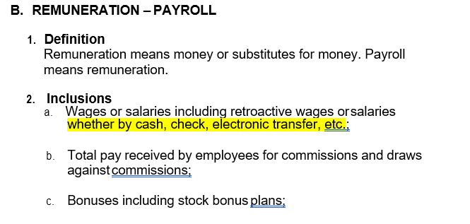
Wisconsin Basic Manual Rule V B.2.a

Slide 3
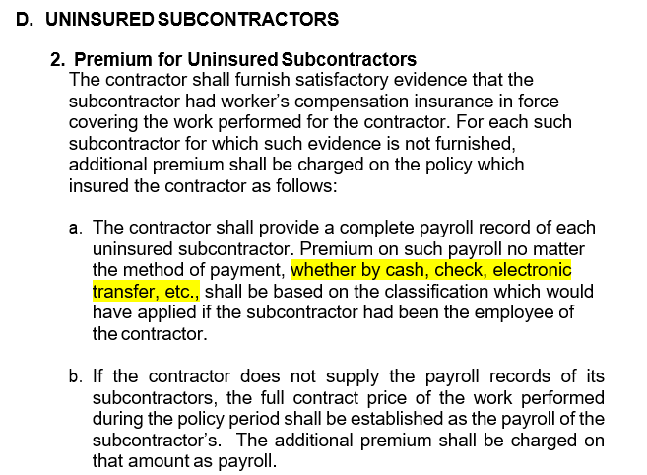
Wisconsin Basic Manual Rule IX D.2.a

Slide 4
Wisconsin Payroll Cash Payment
Adds payments made to workers considered employees by type of work performed outside standard method with either Federal/State taxes are withheld or inclusion in Federal 1099 contractor form
Payment of wages via cash is displayed for policyholder understanding
Strengthens discussion at time of audit for inclusion of contract labor, day labor, uninsured subcontractor cash payment method for inclusion of exposures determined at policy final audit

