Slide 1
Misclassification Task Force DFI Registration Work Group October 11, 2021

Slide 2
Scope of the problem
Bidder Database
Publicly available at https://www.responsiblewisconsin.com/
Public, verifiable information on 11,217 construction contractors (commercial) operating in Wisconsin
2,214 contractors in the database ARE NOT registered/authorized by DFI
A staggering 20% are not in compliance
Most are LLCs
Some domestic but most are foreign entities
This is only one industry in Wisconsin. What would the totals be for all industries?

Slide 3
Scope of the problem (cont’d)
Loss of revenue to the State
$100 for a foreign LLC to file for a certificate of registration; $130 for domestic organization of a new LLC and $100 for reinstatement of lapsed domestic registration
$80 a year for annual report for foreign LLC; $25 a year for annual report for domestic LLCs
Penalty of 50% of all fees that should have been paid for noncompliant foreign entities
Assuming 15% domestic and 85% foreign LLC over one biennium of the State results in nearly $800,000 of lost revenue for noncompliant LLCs in the construction industry only

Slide 4
Scope of the problem (cont’d)

Slide 5
Examination of Other states
50 State Review
Disclosure of LLC owners
Penalties
Illinois & Iowa
Disclosure
Enforcement
Discussion
2

Slide 6
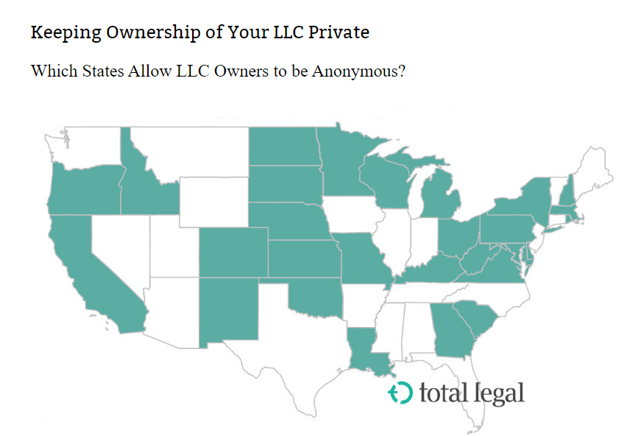
Ownership
Green=No Disclosure of members
White=Disclosure of one or more members/managers
Source, total legal https://www.totallegal.com/llc-privacy-which-states-list-owners
3

Slide 7
Ownership (cont’d)
25 states require one or more members/managers be disclosed in the organizational or subsequently filed documents
Arizona
Arkansas
California
Connecticut
District of Columbia
Florida
Hawaii
Idaho
Illinois
Indiana
Massachusetts
Mississippi
Maine
Montana
Nebraska
Nevada
New Jersey
New Mexico
North Carolina
Ohio* (required by most banks, not by statute)
Oregon
Tennessee
Texas
Utah
Vermont

Slide 8
Consequences of Noncompliance
See handout
Filing Fees & Late Charges/Penalties (usually limited to foreign LLCs)
All States except PA
Cannot Maintain A Legal Action (but may defend a legal action)
All States
Attorney General Can Enjoin from Conducting Business
Only AL, AZ, CA, CO, CT, DE, ID, NY, OK, RI, VT
Civil Fines and/or Criminal Liability for Owners/Agents/Members
Only CA, DE, LA, MD, ND, OH, OK, UT, VT

Slide 9
Illinois
Disclosure of all managers and all members have the authority of a manager for both domestic and foreign LLCs
Domestic creation form, https://www.ilsos.gov/publications/pdf_publications/llc55s.pdf
Foreign LLC registration form, https://www.ilsos.gov/publications/pdf_publications/llc455.pdf
Managers/members disclosed publicly online (see handout)
Enforcement
Adoption of administrative rules is authorized by the LLC act and have been promulgated, https://www.ilga.gov/commission/jcar/admincode/014/01400178sections.html
Illinois Secretary of State does not have an active enforcement program HOWEVER upon notice that a foreign entity is operating in the state without proper registration/authorization they will write to the entity and advise of the legal requirements for registration/authorization

Slide 10
Iowa
Disclosure of at least one member or manager for foreign LLCs
Domestic LLC does not appear to have a mandatory disclosure
Foreign LLC registration form, https://sos.iowa.gov/business/pdf/635_0010.pdf
Managers/members disclosed publicly online (see handout)
Enforcement
Adoption of administrative rules is authorized HOWEVER very few rules apply to LLCs (e.g., biennial report and online filing requirements), https://www.ilga.gov/commission/jcar/admincode/014/01400178sections.html
No apparent active enforcement

Slide 11
Survey Responses
Does your agency have active enforcement authority for entities that do not properly register with you? If so, what penalties are you authorized to impose/assess?
WA: “We are ministerial so there is no enforcement. If there is a conflict in a registration, or lack thereof, we can notify the AG’s consumer protection office or encourage the parties involved to contact the AG or law enforcement for criminal issues.”
NC/IN: “The NC [and IN] Secretary of State has administrative authority and relies upon the interrogatory process and referrals to the Attorney General's Office for any enforcement actions.”
PA: “No. We are primarily ministerial, so there are no enforcement powers/penalties/carrot or stick. The ONLY penalty in existing law is a $500 penalty for not registering a fictitious name and that only comes up in a lawsuit when the opposing party brings it up. If there’s consumer harm, we can notify the AG’s consumer protection office or, like WA, encourage the parties involved to contact the AG or law enforcement for criminal issues.”
LA: “In Louisiana, it is the same as Washington, we are a filing agency only, not an investigative/enforcement one. They can contact the AG’s office or law enforcement on any criminal issues.”

Slide 12
Survey Responses (cont’d)
Are entities required to disclose owners/members/partners to you as part of the registration/filing process? If so, is that information stored in a database? Is it made available to the public?
WA: “We do not track ownership, just the current list of governors either at formation or via initial report. When they go to DOR to get their business licensing, they will be required to disclose ownership and percentages for tax purposes, but it is not a public record.”
NC: “The NC Secretary of State does not collect ownership information; however, the members, partners, company officials are required to be listed on the annual report and updated within 60 days when changes are made. Information contained on the annual report is public record except the email address, which is redacted.”
IN: “Same as NC, but the reports are biennial.”
PA: “No – only General Partners of a limited partnership must be specified upon filing. At this time, PA has no annual reports for all entities and no associated requirement to list one or all governors.”
LA: “We do ask for officers/members/managers/partners at filing and it is recorded in our database and all this information is available to the public.”

Slide 13
Discussion
Disclosure of members/managers of LLCs?
Enforcement and rulemaking authority to DFI?
AG and/or DA authority to enjoin transacting business until compliant?
Expand felony provisions from WI LLPs?
Civil or criminal penalties on owners and/or agents?
Others to consider?

